Slide 1
SOC Home Lab Project #2: Kali Linux Attack Simulation & Brute Force Detection in Splunk SIEM
By vignesh kilambi

Slide 2
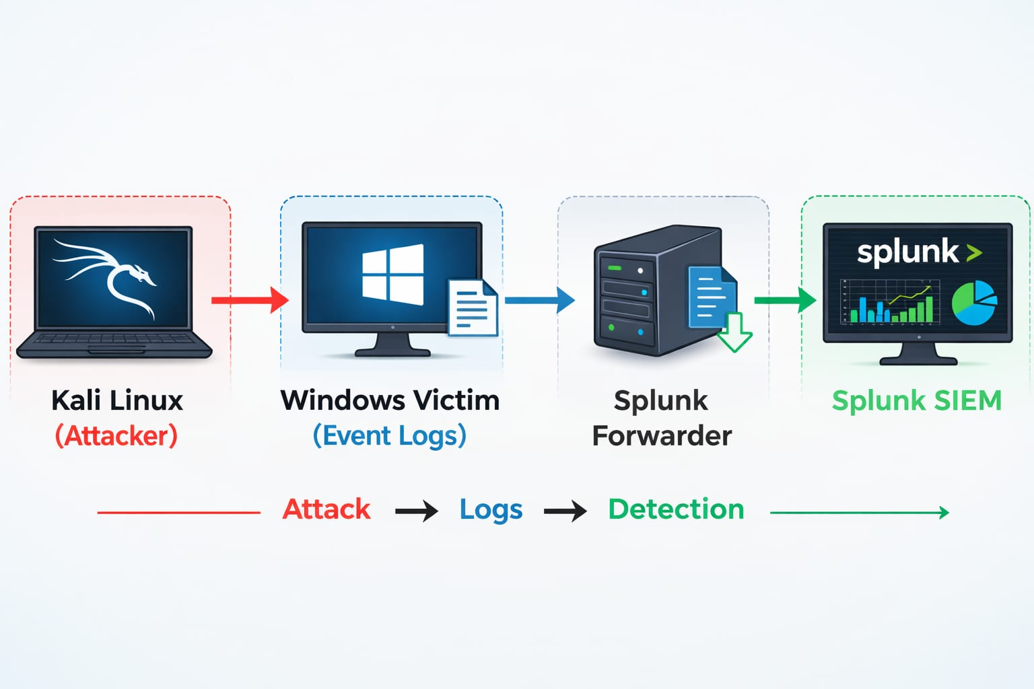
SOC Home Lab Architecture

Slide 3
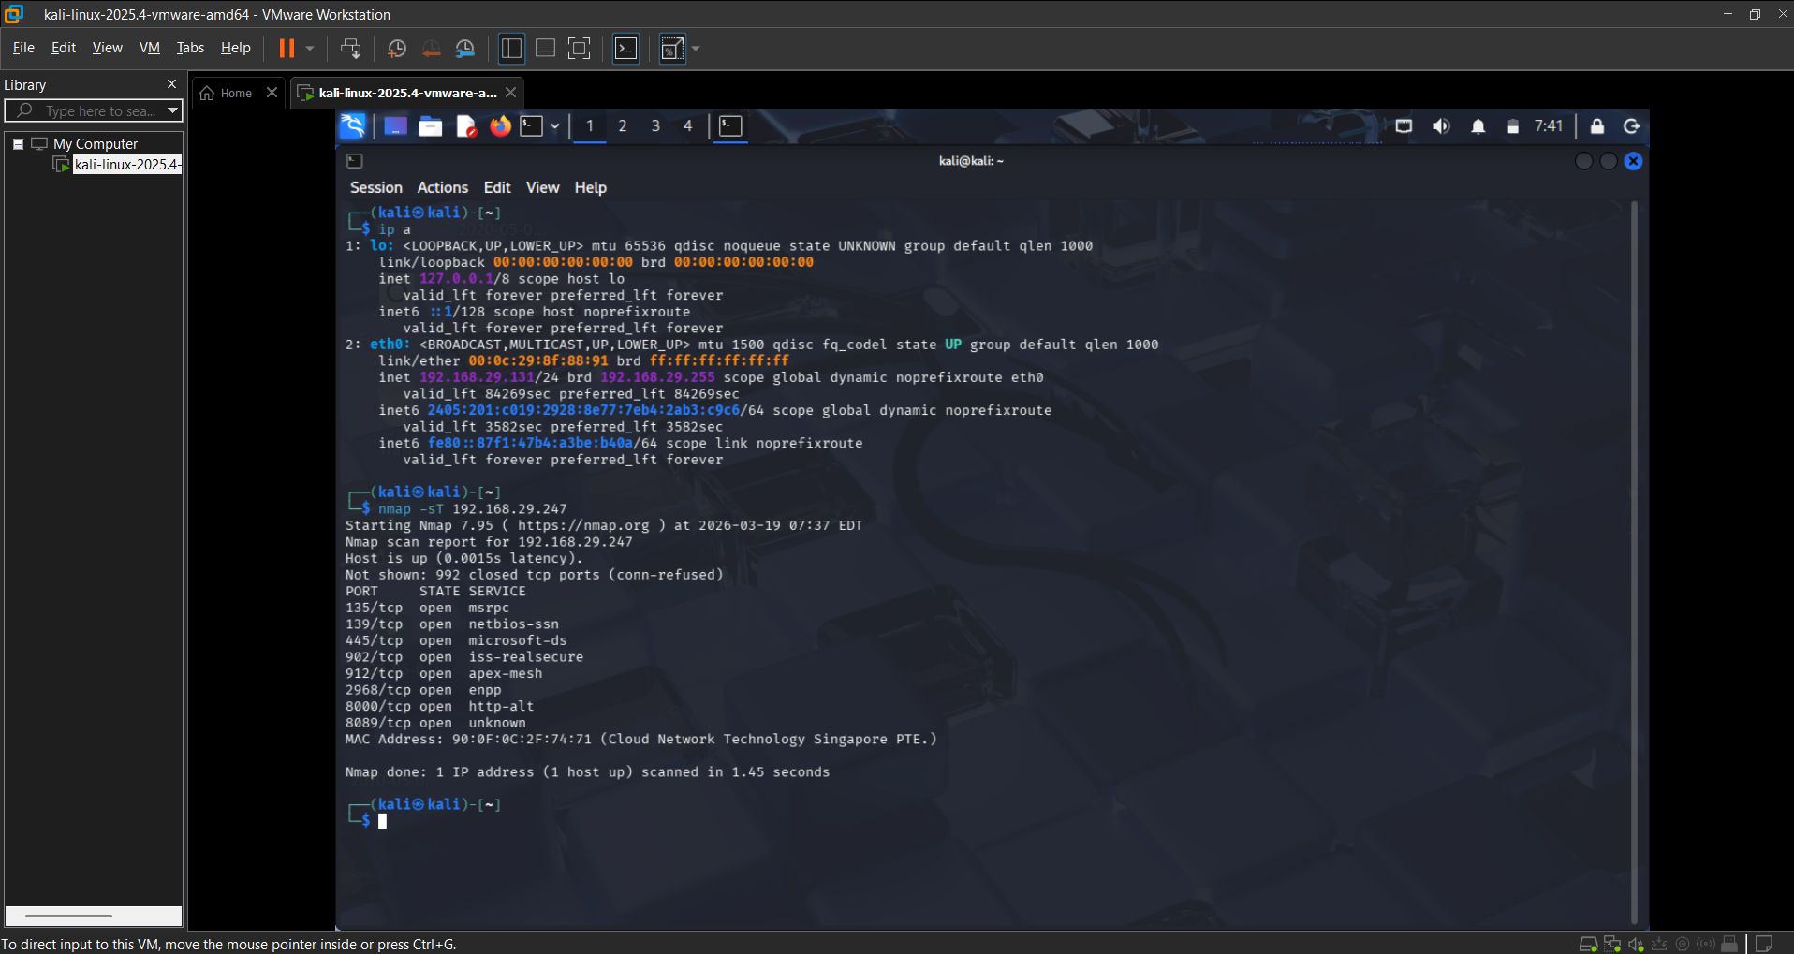
Attack Simulation from Kali Linux (Nmap Scan)
Kali Linux was used to simulate an attacker performing reconnaissance on the Windows system using Nmap.
Command: nmap -sT 192.168.29.247 (Target IP)
Attacker IP: 192.168.29.131 – Generated network activity captured in logs.

Slide 4
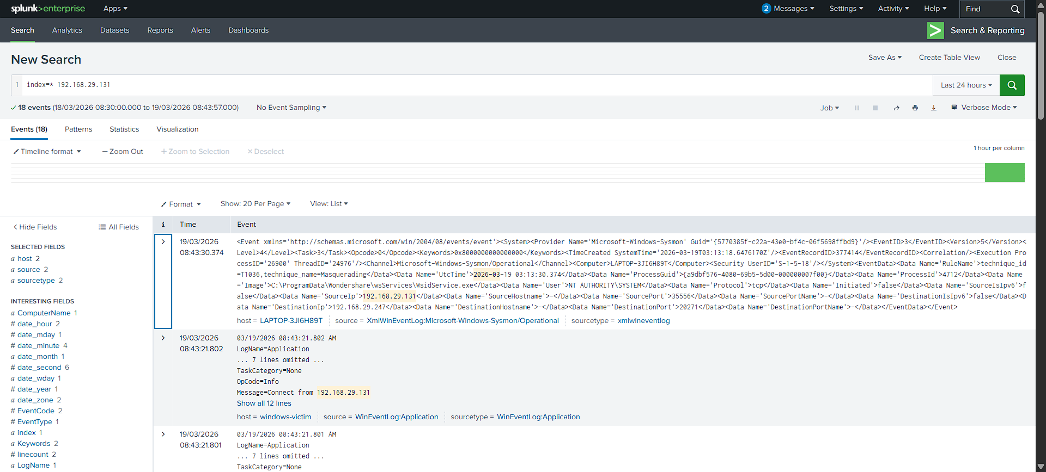
Detecting Attacker IP in Sysmon Logs
Sysmon Event ID 3 logs captured network connections between the Kali Linux attacker and the Windows victim system.
Attacker IP (Kali): 192.168.29.131 Victim IP (Windows): 192.168.29.247

Slide 5
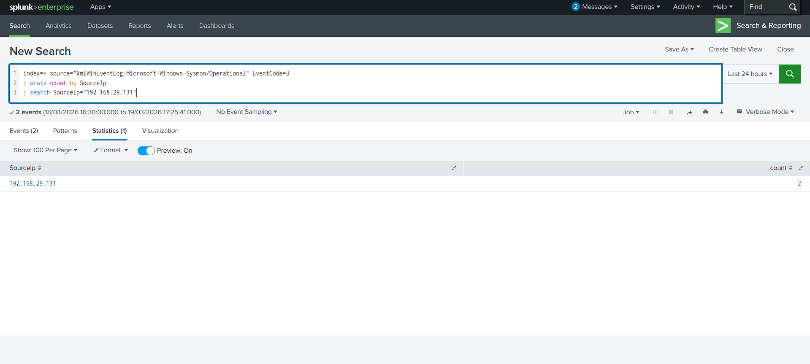
Analyzing Network Connections Using Splunk
Splunk was used to analyze Sysmon network logs and identify communication between attacker and victim systems.
This helps SOC analysts detect suspicious network activity and trace attacker behavior.

Slide 6
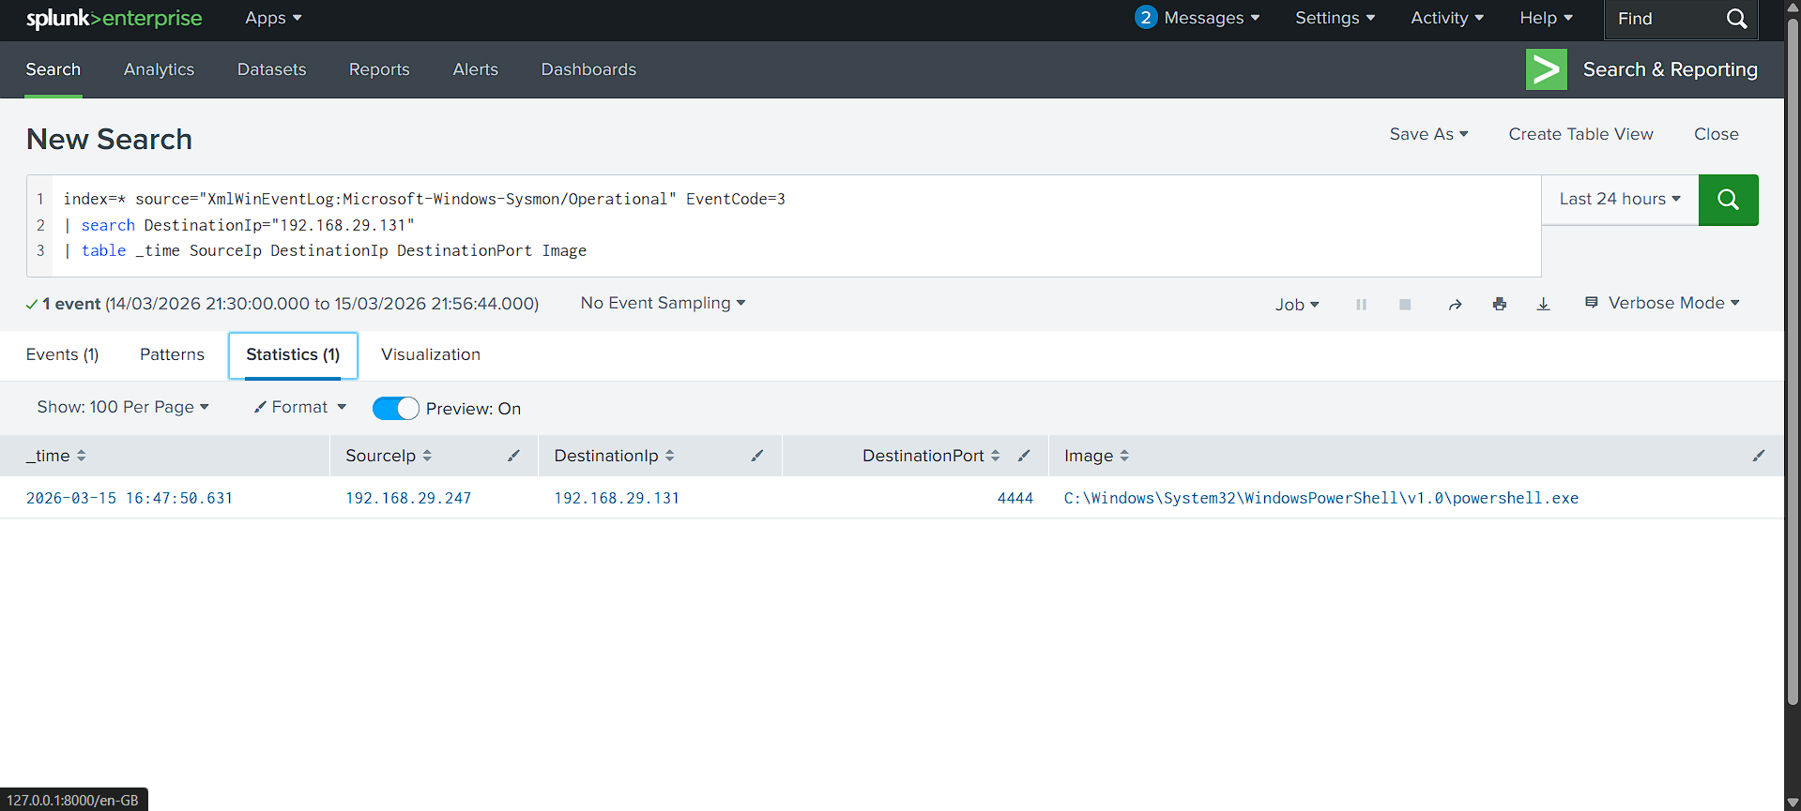
Detecting Outbound Connections
Windows system initiated a connection to the Kali attacker machine.

Slide 7
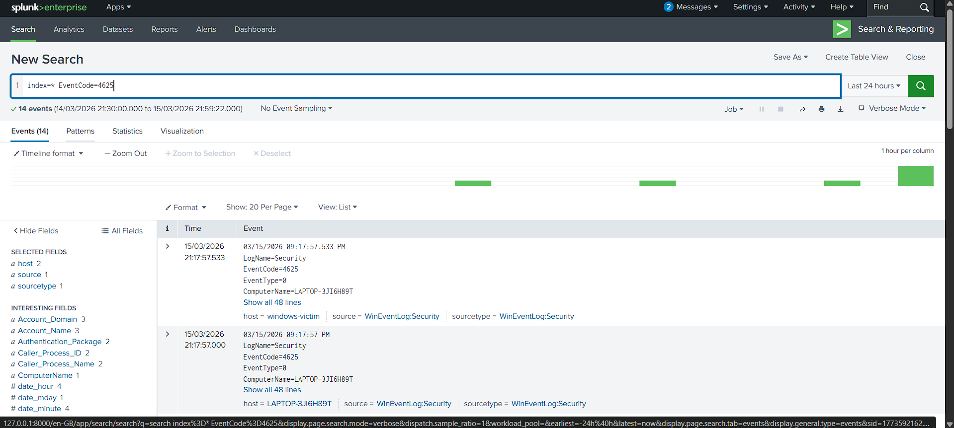
Brute Force Attack Detection
These events are useful for detecting brute-force attacks.

Slide 8
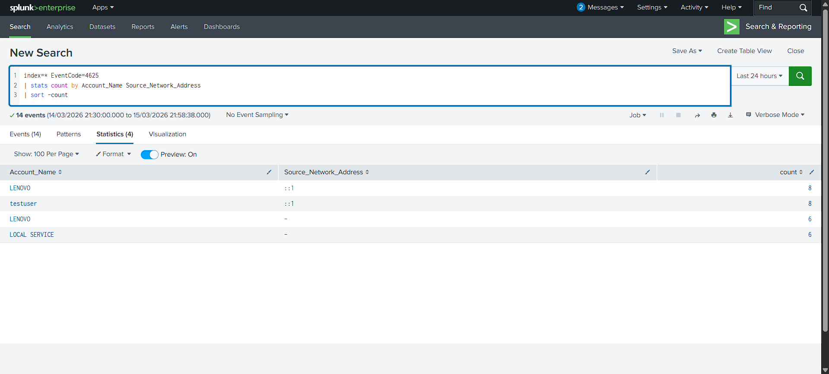
Brute Force Detection Query
This query aggregates failed login attempts and identifies accounts experiencing suspicious login failures.

